Slide 1
3D Image Segmentation and Quantification of Lysosomes
16/4/2025

Slide 2
SPOTIFLOW
DOCUMENTATION
https://www.nature.com/articles/s41592-025-02662-x(PAPER)
https://weigertlab.org/spotiflow/
https://pypi.org/project/napari-spotiflow/
https://forum.image.sc/t/qupath-extension-spotiflow-is-now-available/115646

Slide 3
MY SCRIPT AND SPOTIFLOW
Difference
 | MY SCRIPT | SPOTIFLOW
DETECTION | classical image processing | deep learning model
METHOD | LoG (blob_log) + Gaussian fit + radial refinement | trained neural network → spot prediction
ASSUMPTION | blobs are roughly Gaussian + symmetric + intensity-driven | model has learned what a lysosome looks like (shape + context)

Slide 4
MY SCRIPT AND SPOTIFLOW
Pipeline logic comparison
STAGES | MY SCRIPT | SPOTIFLOW
1 | CHANNEL 1(LYSOSOMES) detect blobs → refine radii | Ch2 → segment cells (FIRST) → build mask
2 | CHANNEL 2(CELLS) segment cells | Ch1 → detect ONLY inside mask (Spotiflow)
3 | classify lysosomes into cells | → refine radii → classify lysosomes
Spotiflow uses biology (cell mask) to guide detection.
My script is blind detection everywhere.

Slide 5
MY SCRIPT AND SPOTIFLOW
Detection strategy
 | MY SCRIPT | SPOTIFLOW
Strengths | No training dependency Good when: 2-Spots are round 3-Background is relatively uniform | Learned features: 1-shape 2-intensity patterns 3-local context Much more robust to: 1-variable illumination 2-heterogeneous background 3-structured noise Built-in suppression: 1-prob_thresh 2-min_distance
Weaknesses | Sensitive to: 1-background gradients 2-illumination changes 3-noise spikes Requires tuning: 1-BLOB_THRESHOLD 2-sigma ranges Produces: 1-false positives in noisy regions 2-missed dim lysosomes | Model: trained on smFISH, not lysosomes May: 1-miss unusual morphologies 2-over-detect in textures similar to training data Less interpretable

Slide 6
MY SCRIPT AND SPOTIFLOW
Advantages vs Disadvantages
 | MY SCRIPT | SPOTIFLOW
Advantages | Simple Transparent Fully controllable No dependency on pretrained model . Works well on clean data. | Robust to noise and illumination. Uses biological mask → fewer false positives. Better detection of weak signals Less parameter tuning needed. More consistent across datasets.
Disadvantages | Very sensitive to noise. Needs manual tuning per dataset. Not robust to illumination variation. Detects outside cells → wasted detections. Struggles with dim or irregular lysosomes. | Depends on pretrained model. Harder to debug. May miss atypical lysosomes. Slightly heavier computationally.

Slide 7
CONCLUSION
SPOTIFLOW
According to the Spotiflow documentation I can research, it works best with images that have illumination variation and a lot of noise. However, the training model I use, called Sm Fish 3D, is not yet able to detect the correct geometry of lysosomes, which leads to over detection and many false positives. It can't capture the center of the spots or their shape, giving me incorrect radii. Its weakness is that it's not based on lysosomes, and I would have to research how to train a new model from scratch, which would take more time.
MY SCRIPT
Regarding my script, when dealing with noisy images and illumination variation, it needs to define more parameters, making it less automated and adaptable to other types of images, although it does manage to better capture the geometry and location of the centers of each lysosomes.
On the other hand, I could try to improve the preprocessing before detection and try to automate more parameters.
SOLUTION
What I propose is, in order not to delay the project any further, while I process the new images, I will improve the preprocessing of my script to eliminate as much noise as possible and look for ways to automate more parameters.

Slide 8
L3 1 WITH SPOTIFLOW

Slide 9
SPOTIFLOW
I managed to get the model to run only on the mask I generated earlier, so I no longer detect thousands of spots, but I still have false positives within the cells.
Remove some sections to obtain the cleanest possible mask during preprocessing before applying Spotiflow. Use 2 parameters in the Spotiflow model.

Slide 10
SPOTIFLOW PARAMETERS
The parameters in Spotiflow:
1)Probability threshold:
The model assigns a probability (confidence) to each potential spot. Only detections above this threshold are kept.
Effect:
Lower value (e.g., 0.3–0.5) → more sensitive→ detects more spots, but increases false positives
Higher value (e.g., 0.6–0.8) → more strict→ fewer false positives, but may miss weak/low-intensity spots
2)Minimum distance:
This controls how close two detected spots are allowed to be.
It enforces a minimum distance (in pixels/voxels) between detected spot centers.
If two detections are closer than this, typically only one is kept (usually the stronger one).
Effect:
Smaller value → allows tightly packed spots→ risk of over-segmentation (multiple detections in one object)
Larger value → enforces separation→ prevents duplicates, but may merge nearby distinct spots

Slide 11
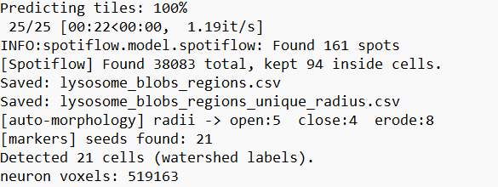
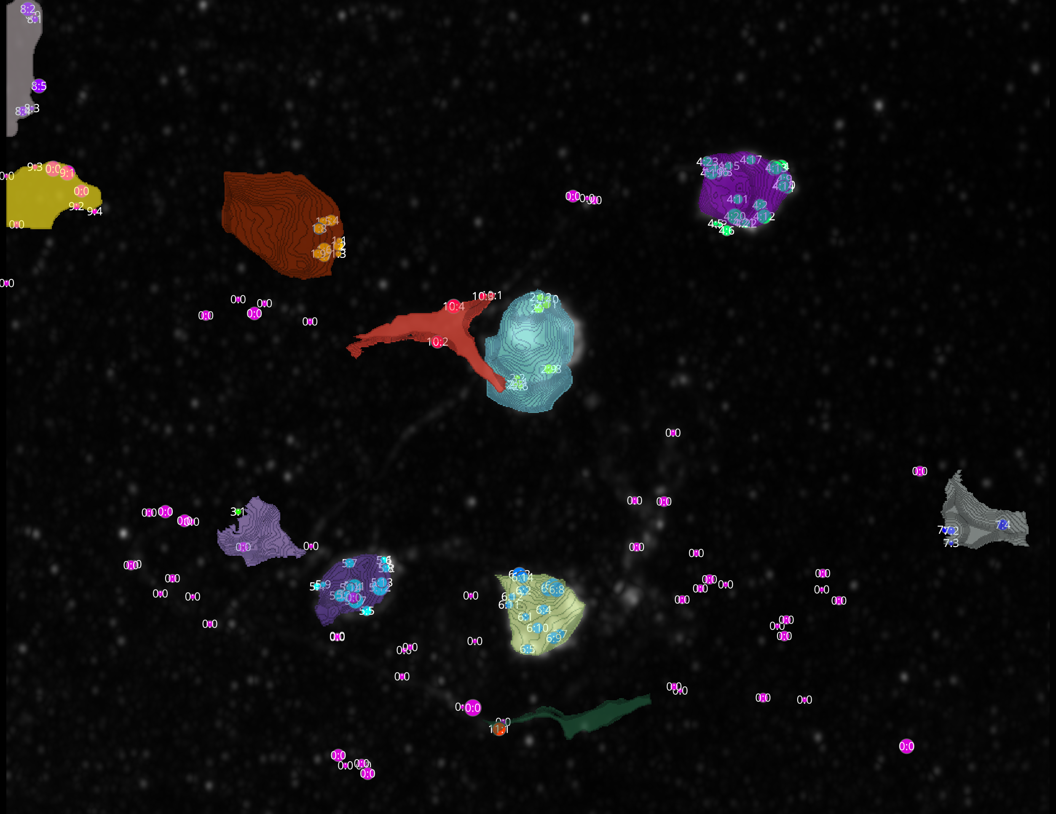
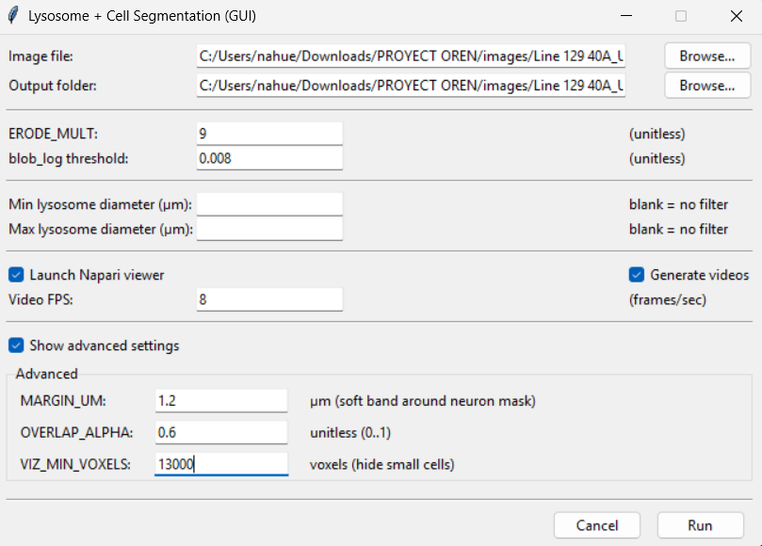
L3-1
SPOTS DETECTED

Slide 12
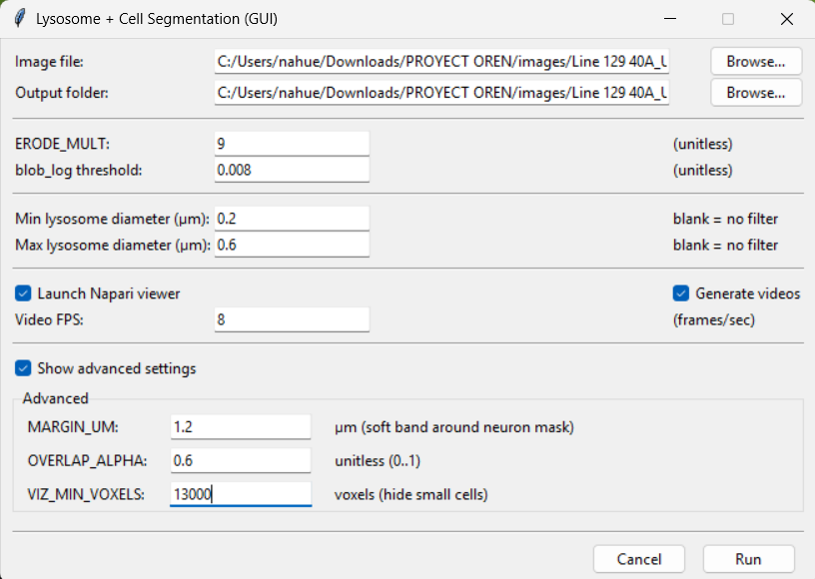
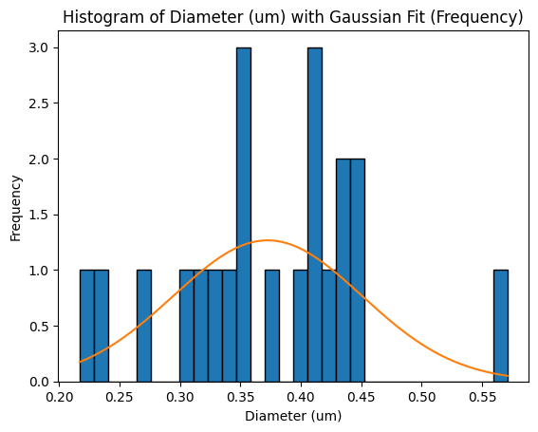
L3-1
In the GUI set an interval of 0.2–0.6, based on the histogram of diameters I obtained from L3–1 with my script, not SPOTIFLOW.
NOT
SPOTIFLOW

Slide 13
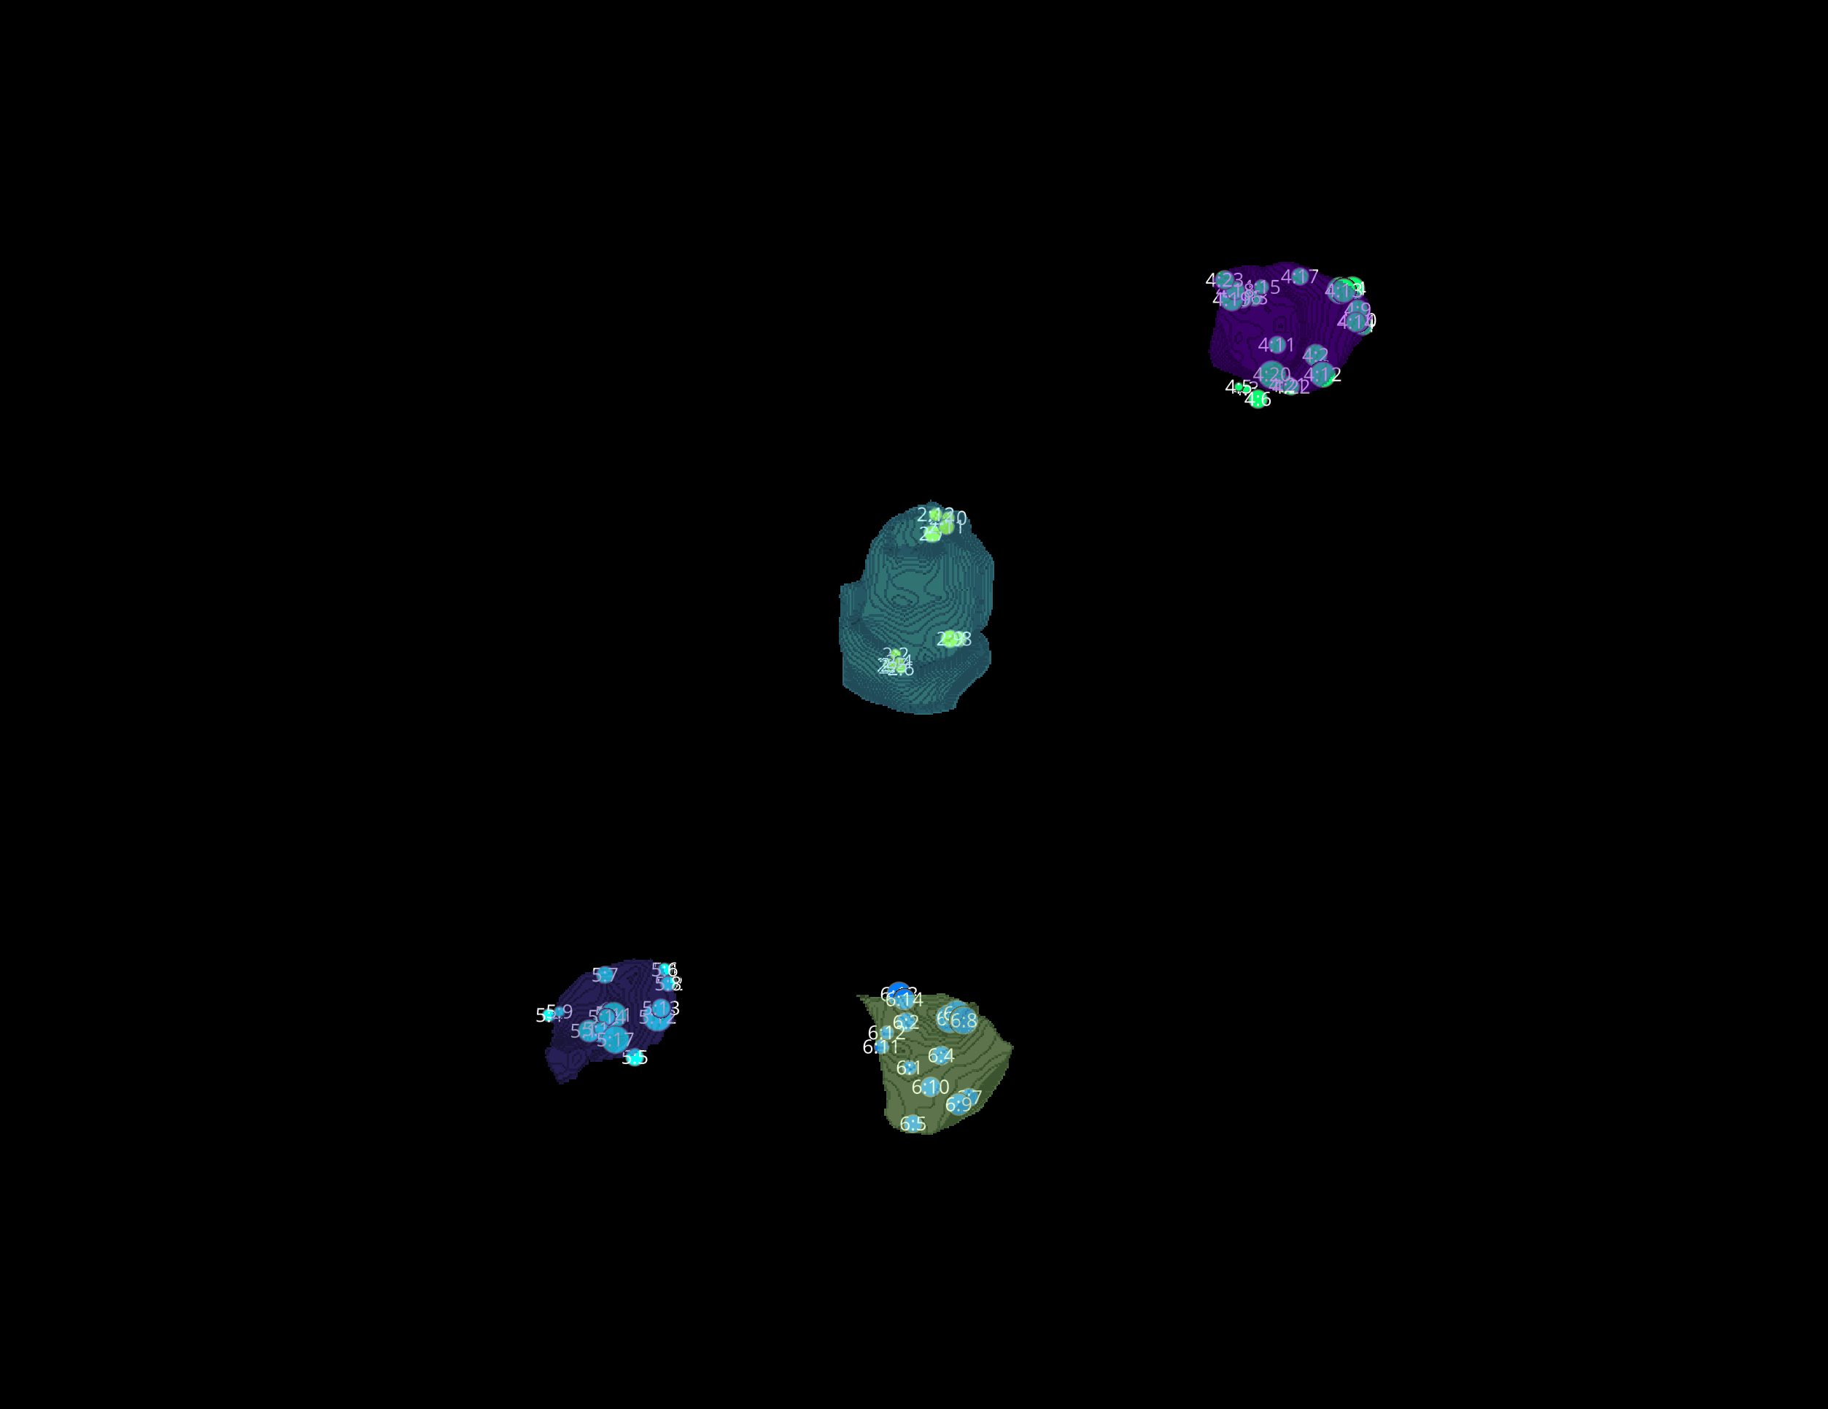
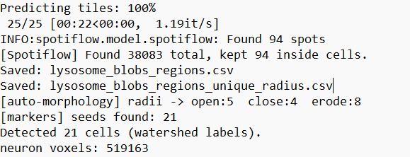
L3-1
SPOTS DETECTED
Finally, in the Napari interface, I filtered out SPOTS outside of cells and detected them in regions that are not cells, just background noise.

Slide 14
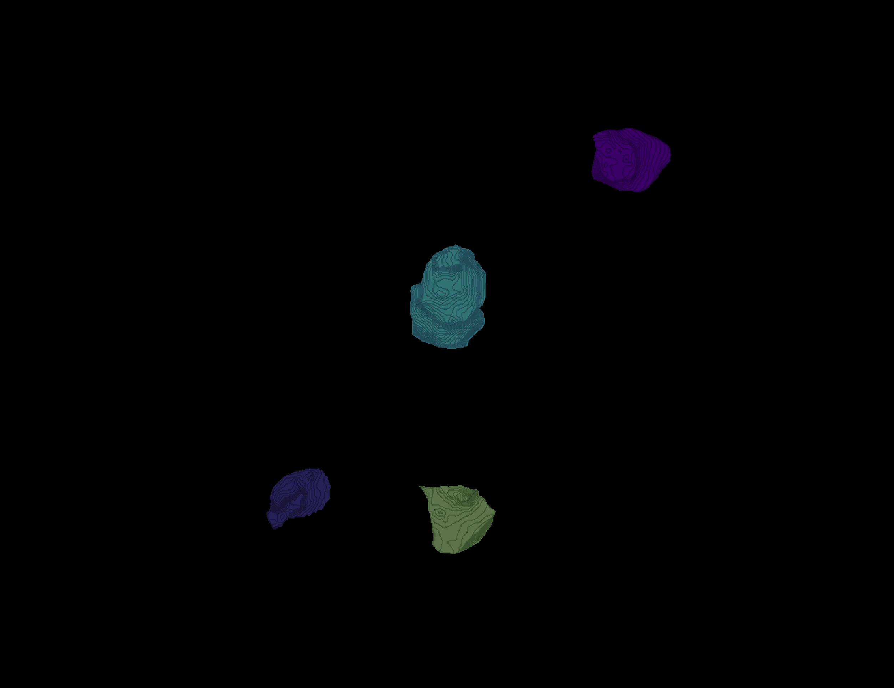
L3 1
Erosion = 9
Thresholding = 0.008
margin um = 1.2
overlap alpha = 0.6
viz min voxels = 13000
SPOTIFLOW
PROB THRES = 0.6
MIN_DIST=4

Slide 15
L3 1

Slide 16
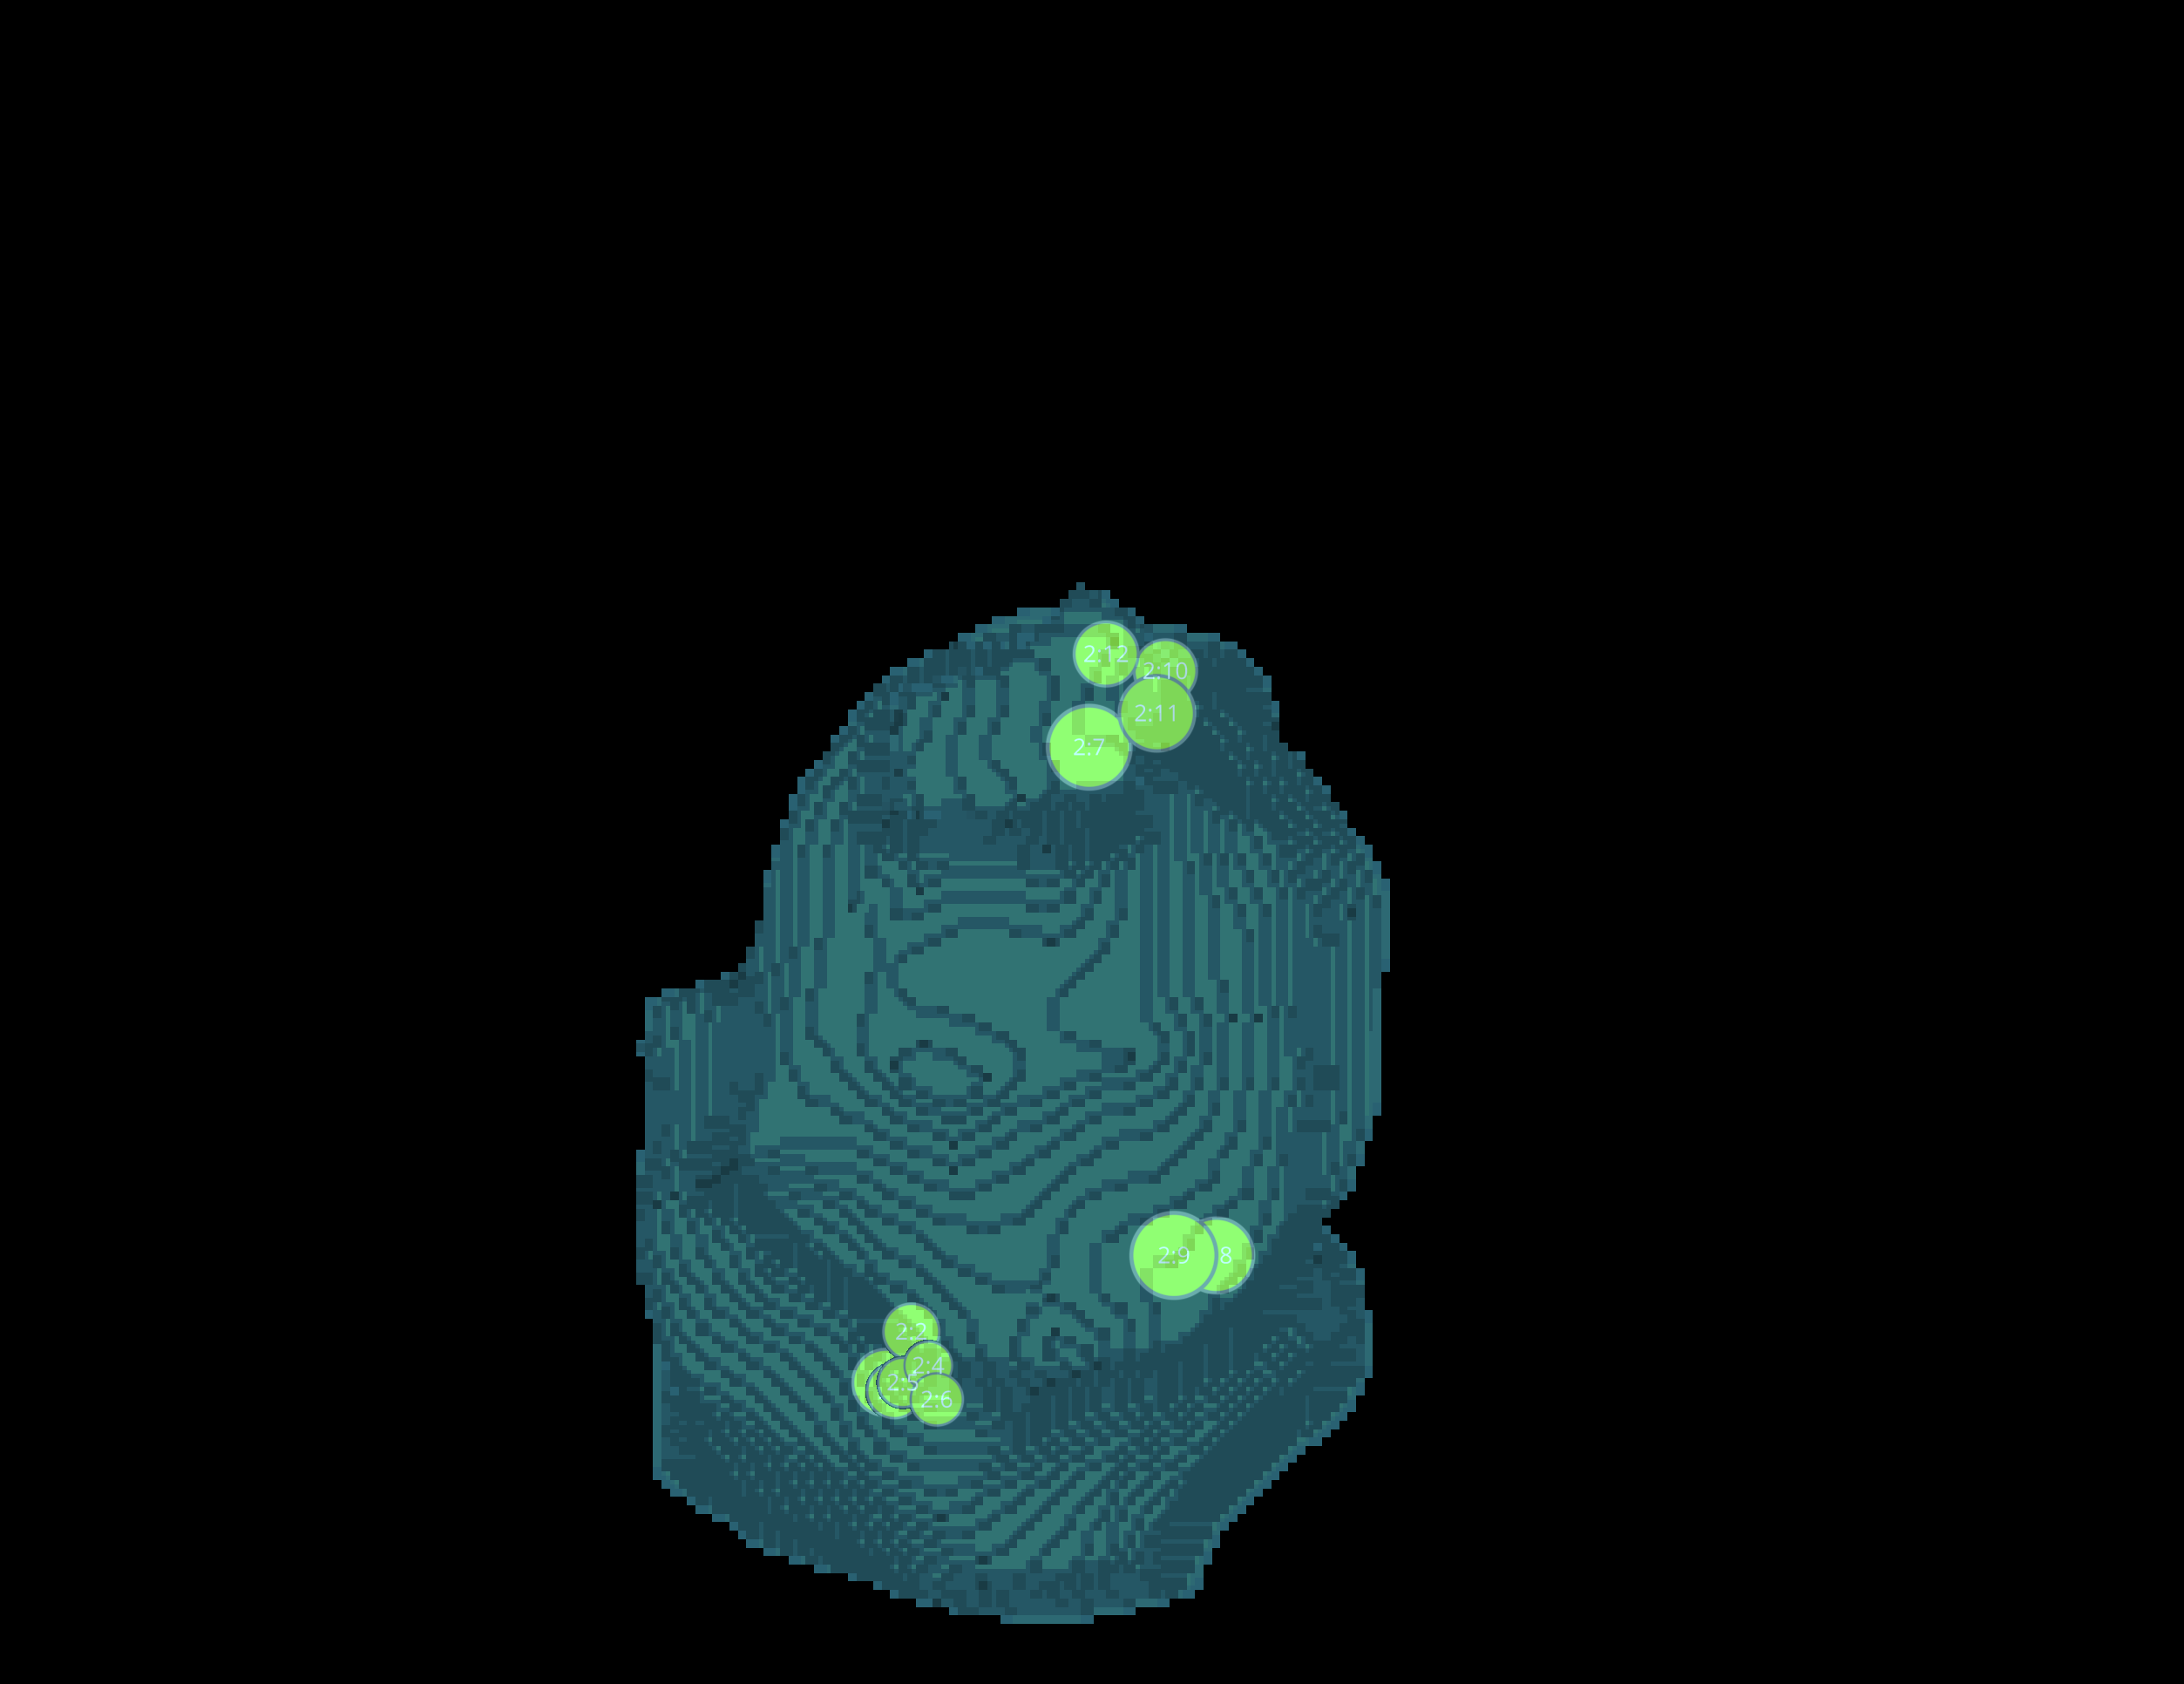
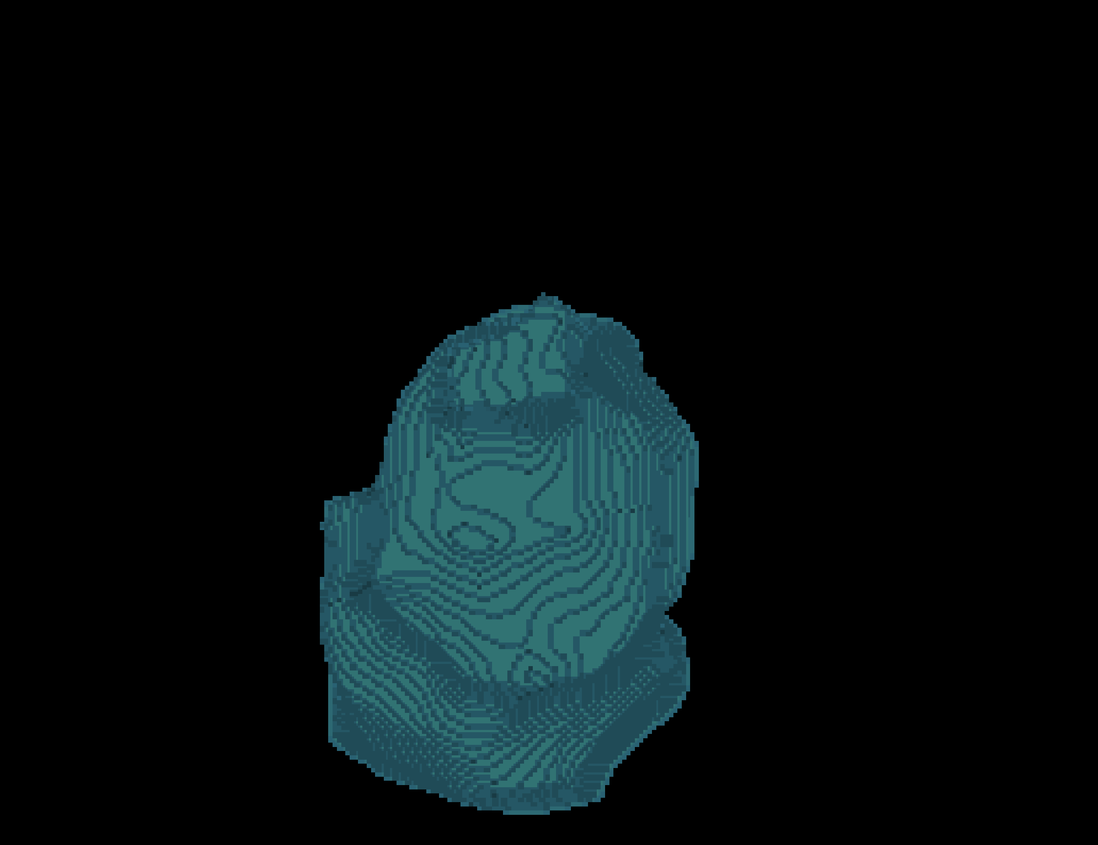
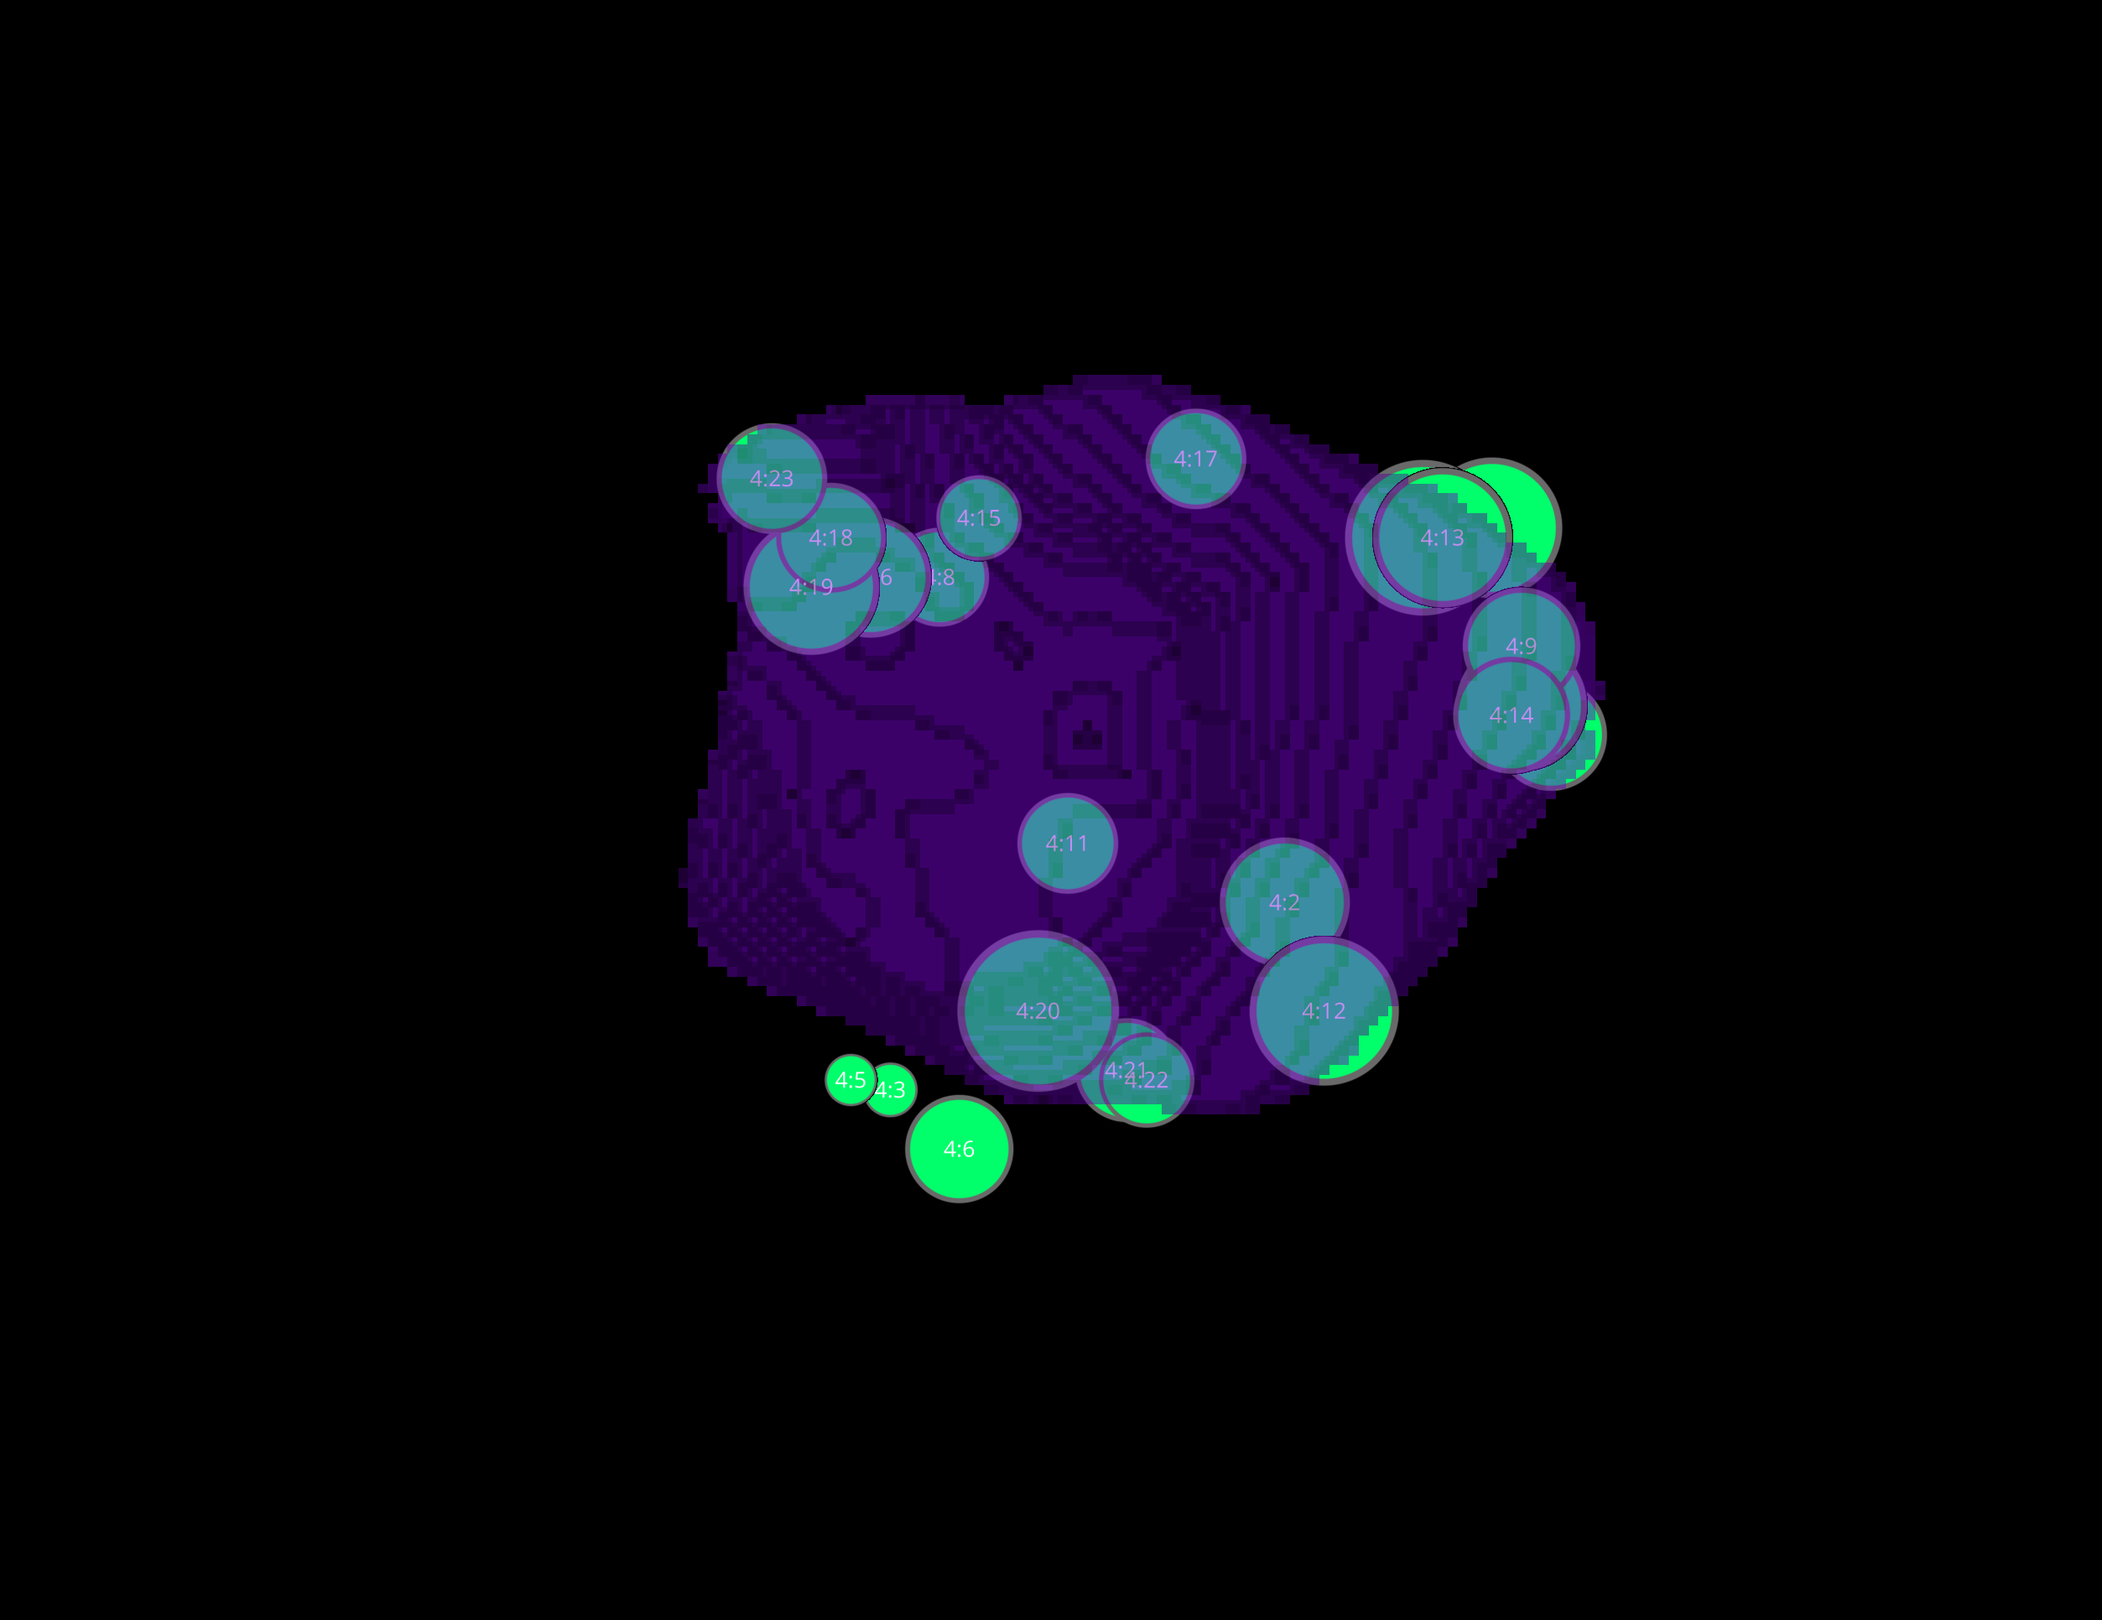
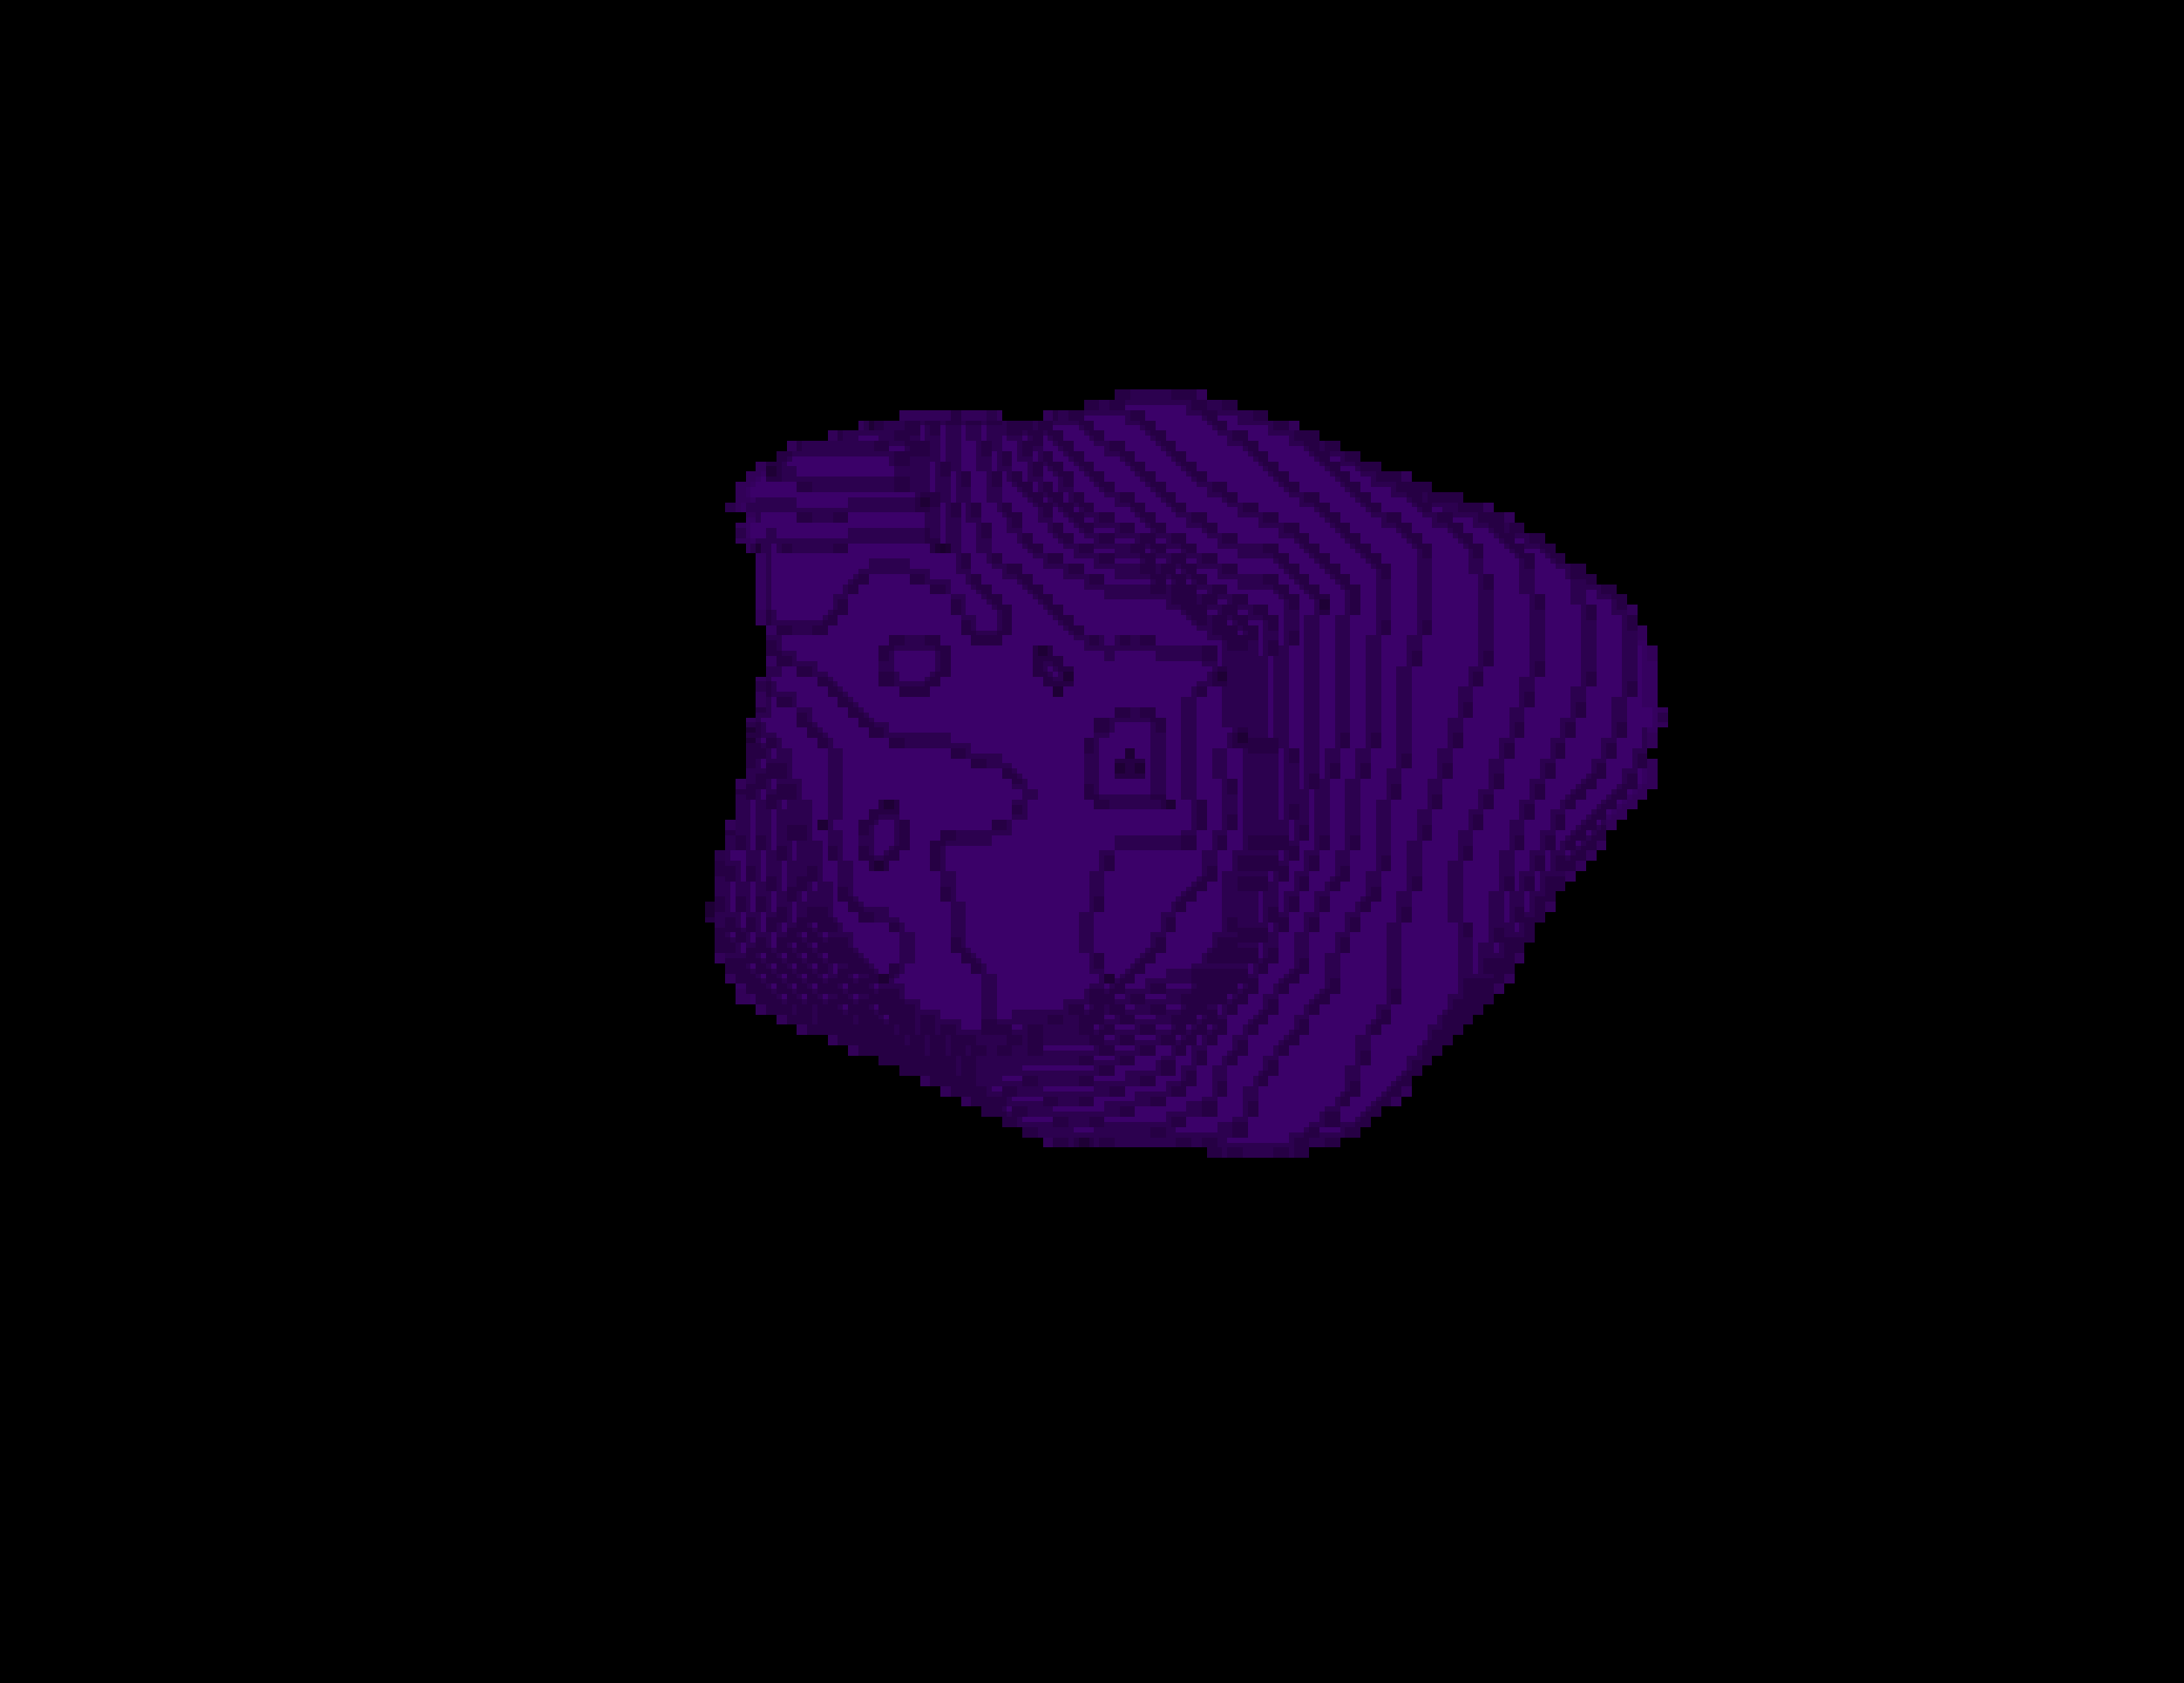
L3 1 CELLS

Slide 17
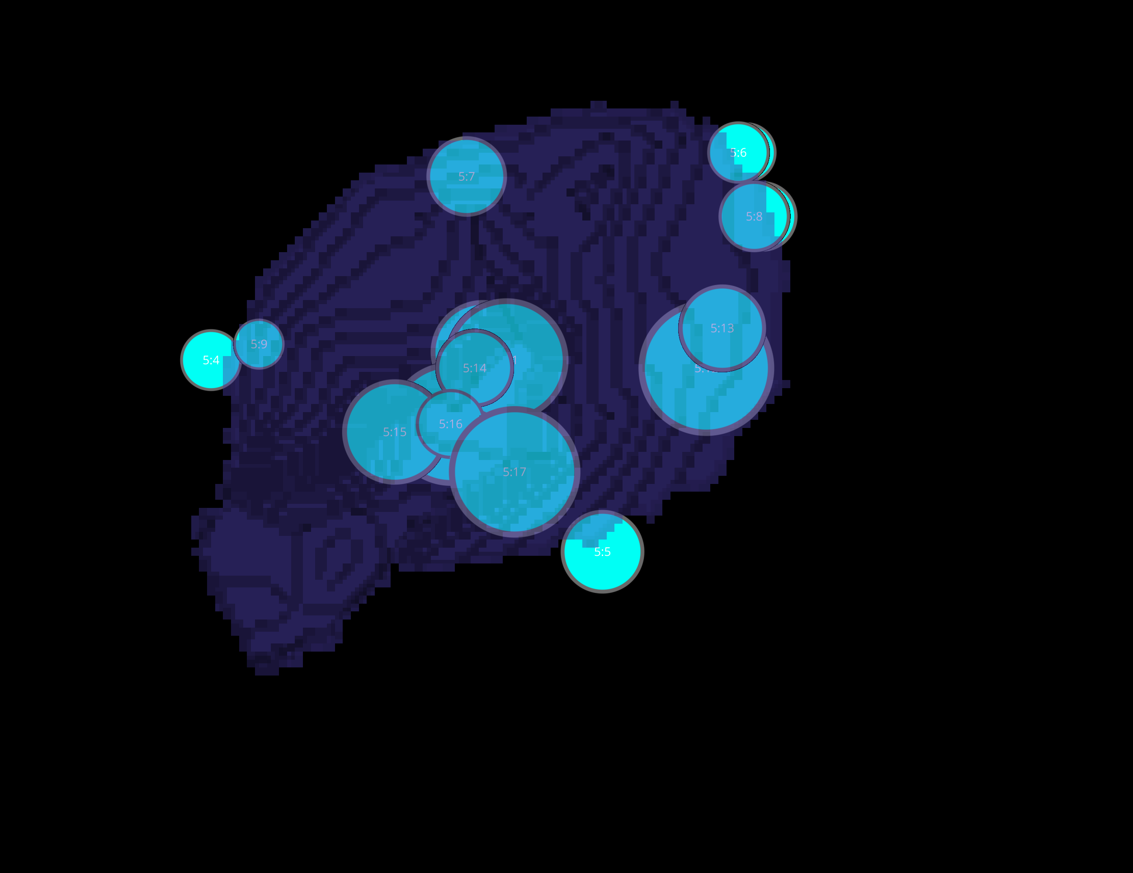
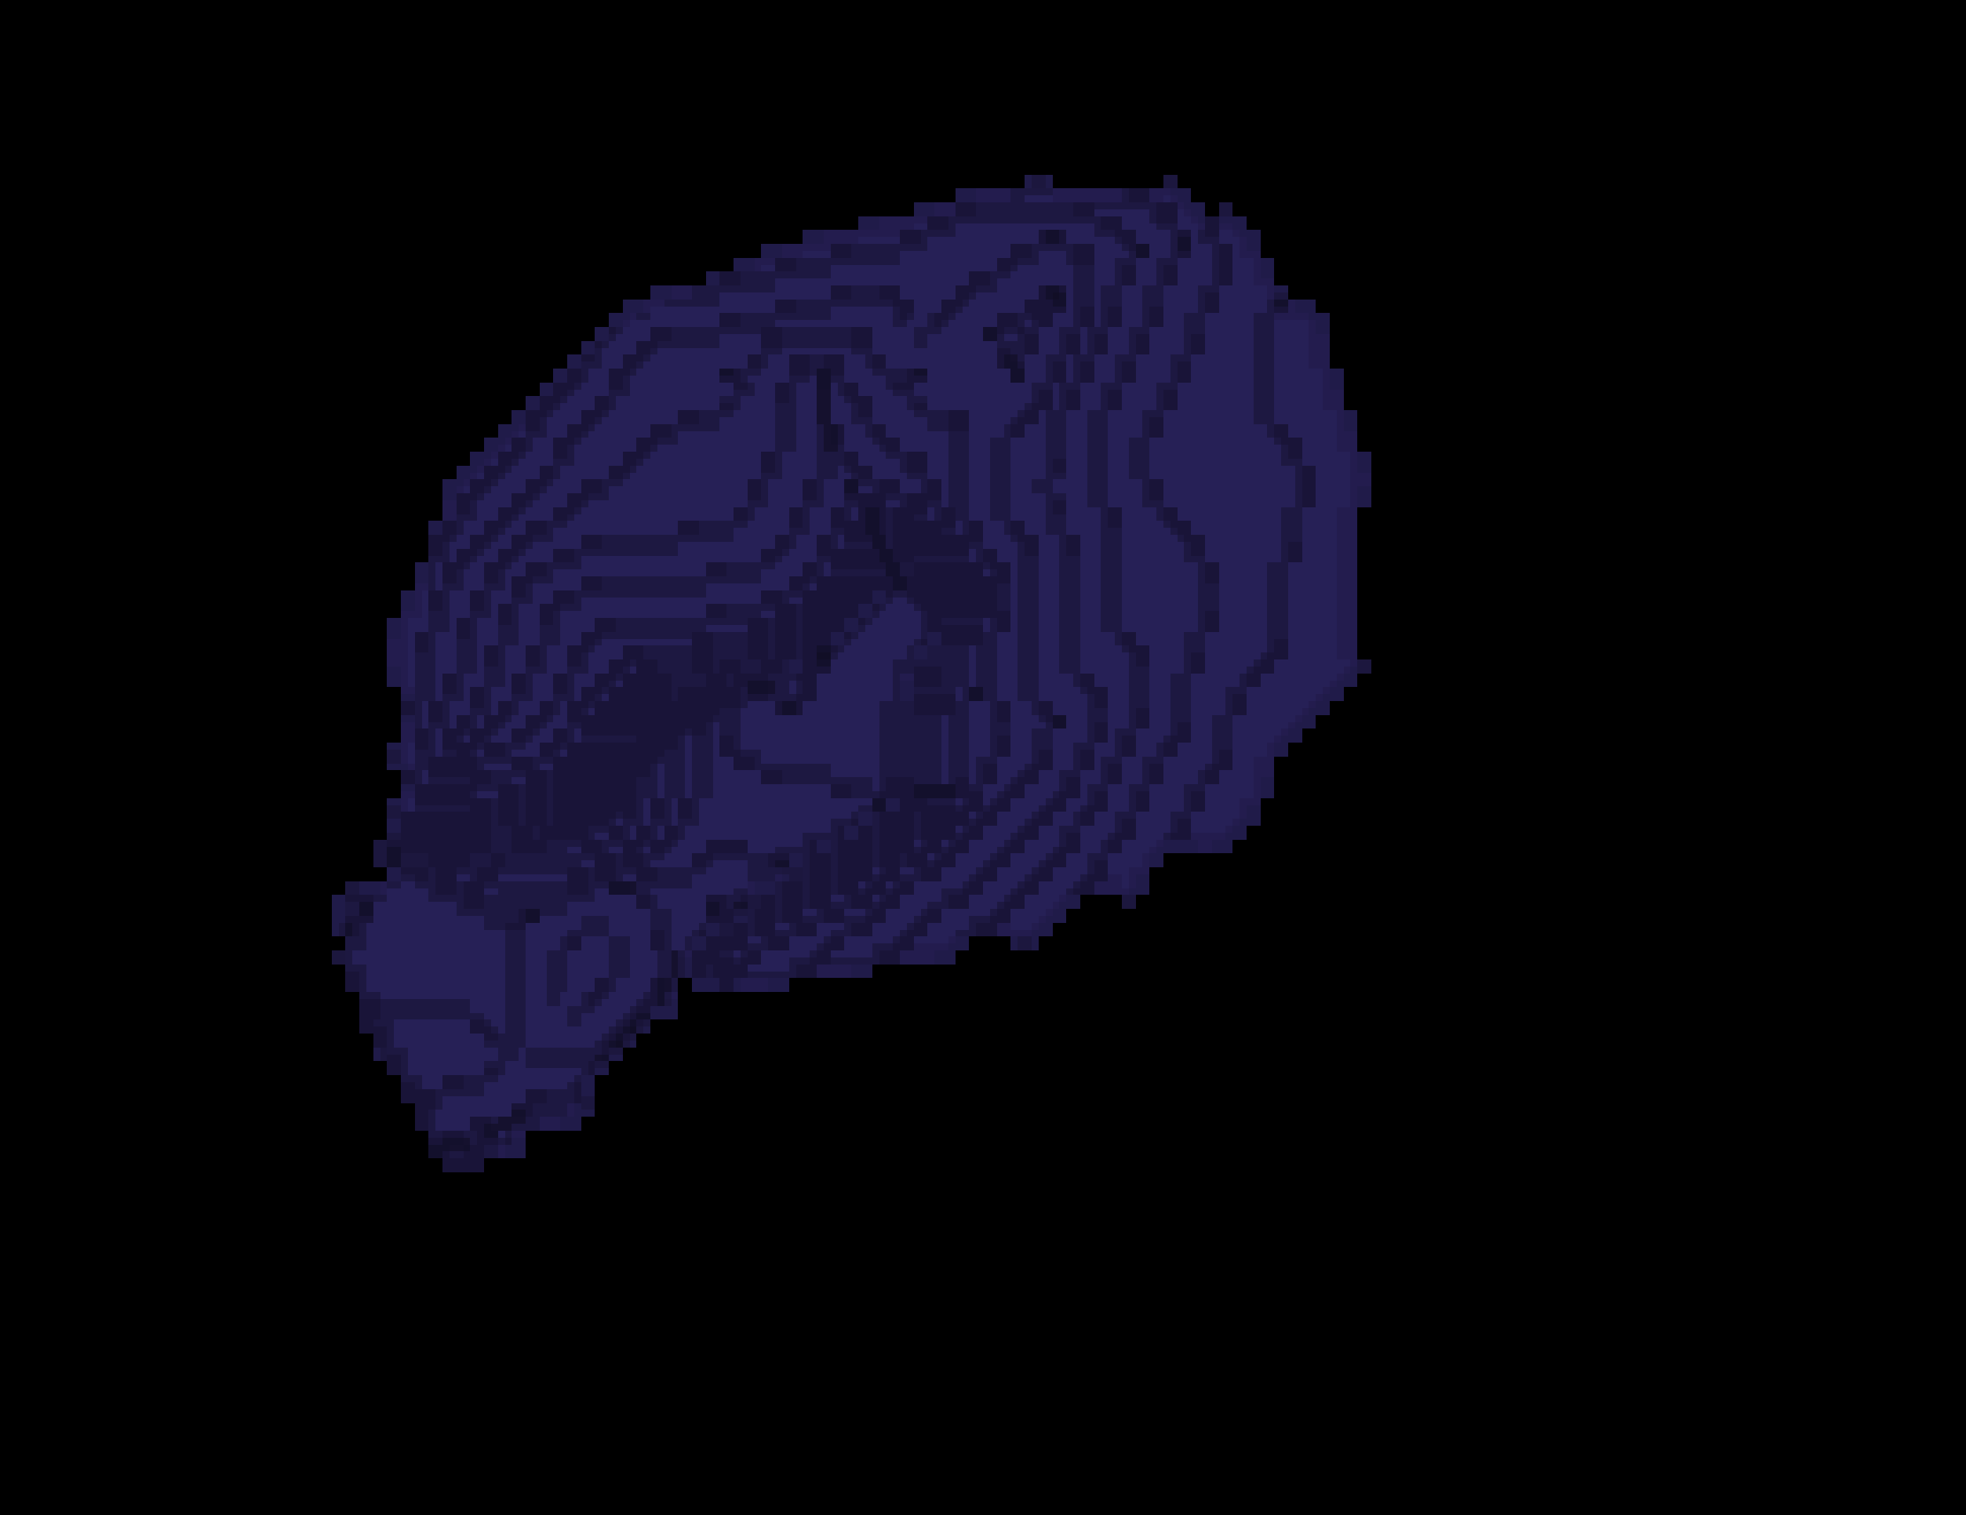
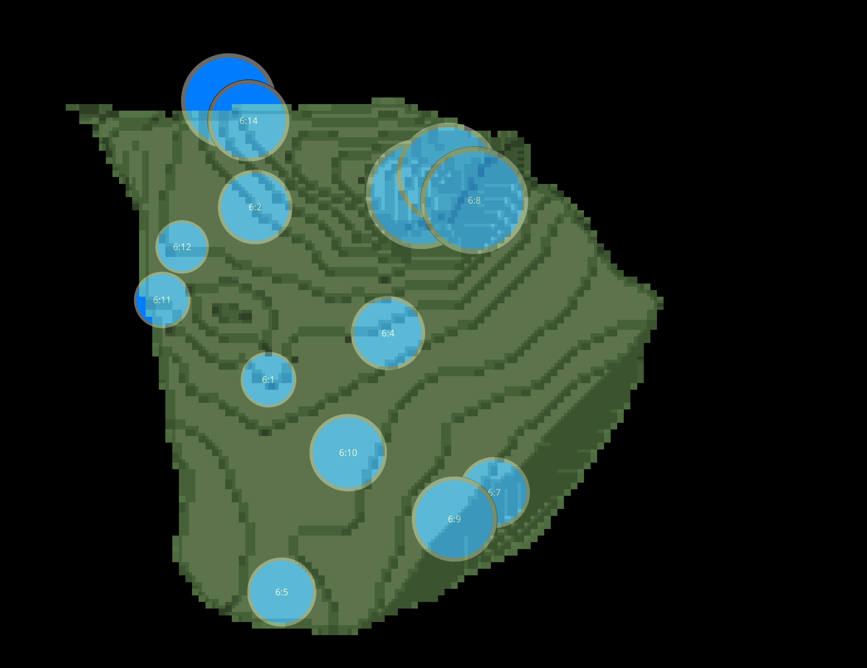
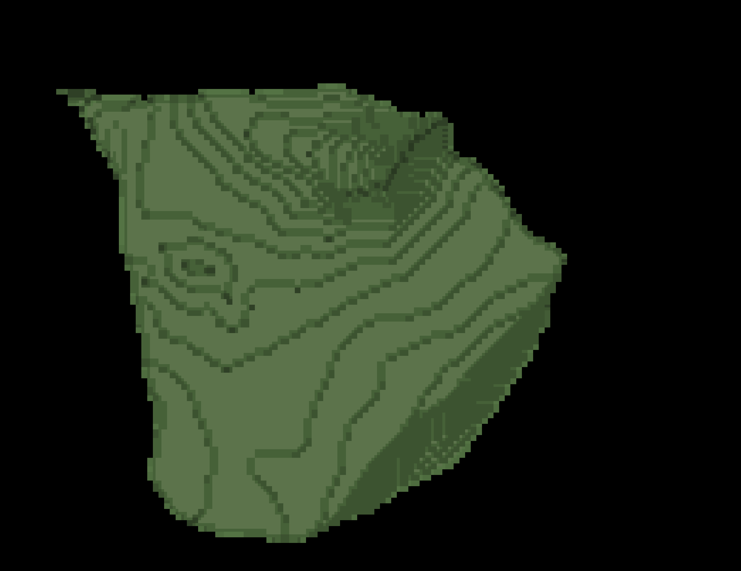
L3 1 CELLS

Slide 18
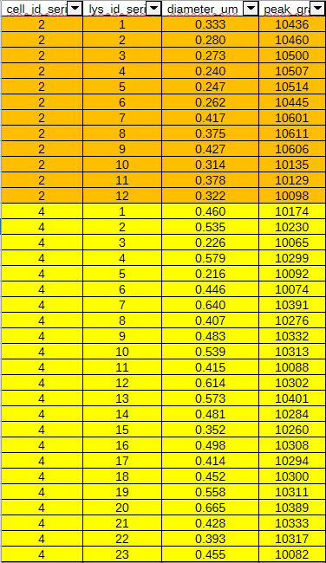
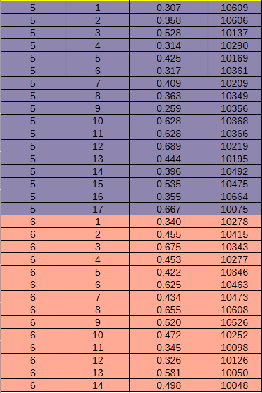

DATASETS L3-1

Slide 19
L3 1 SCRIPT WITHOUT SPOTIFLOW

Slide 20
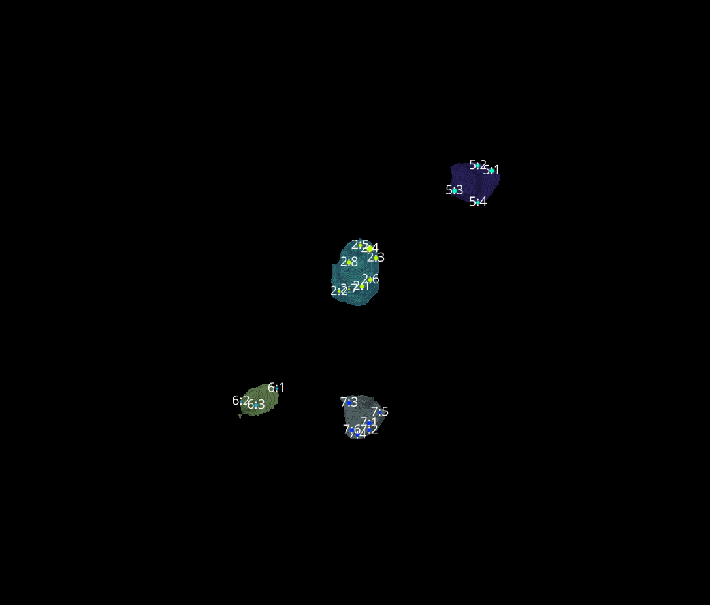
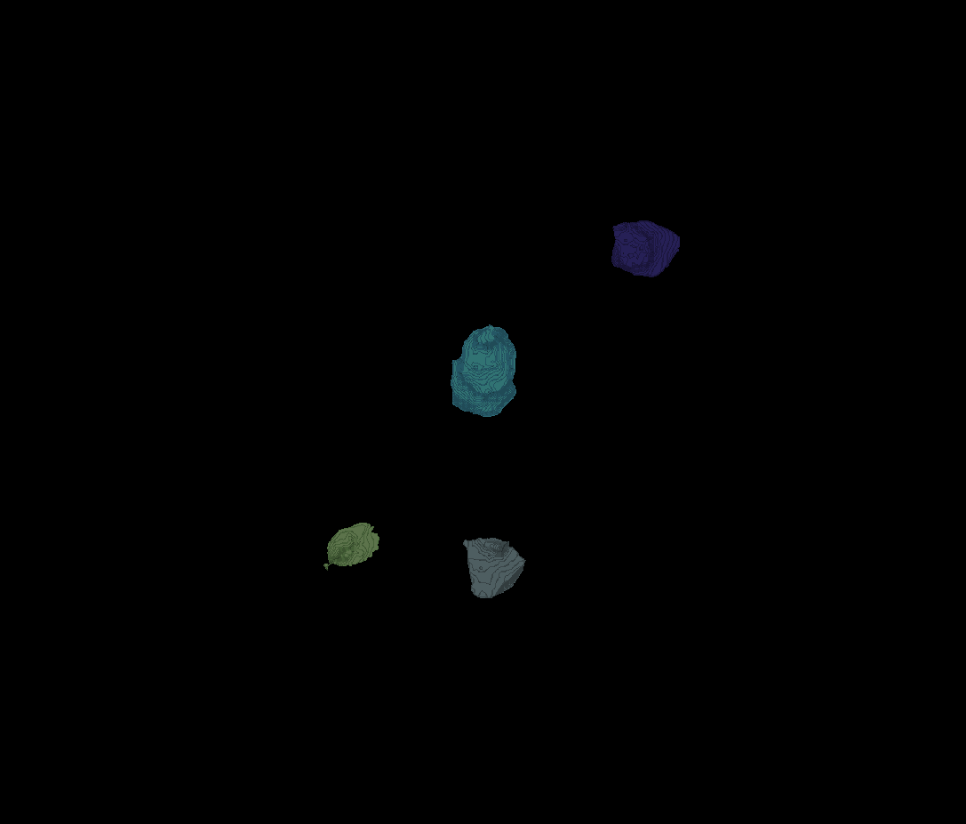
L3 1
Erosion = 8
Thresholding = 0.0025
margin um = 1.2
overlap alpha = 0.6
viz min voxels = 12000

Slide 21
L3 1

Slide 22
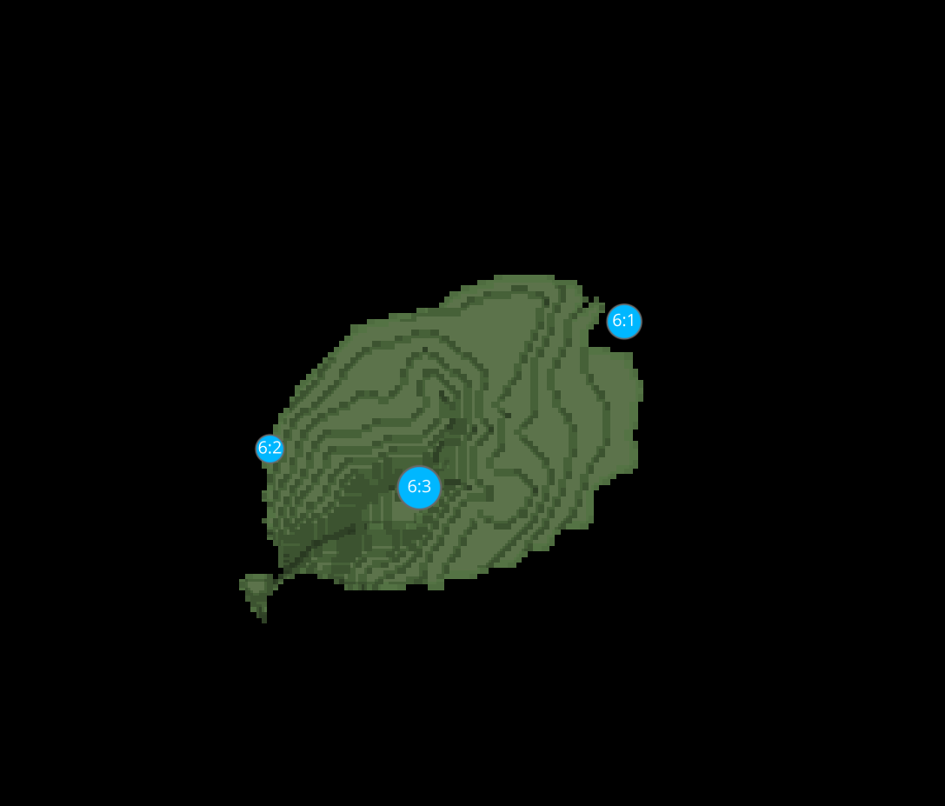
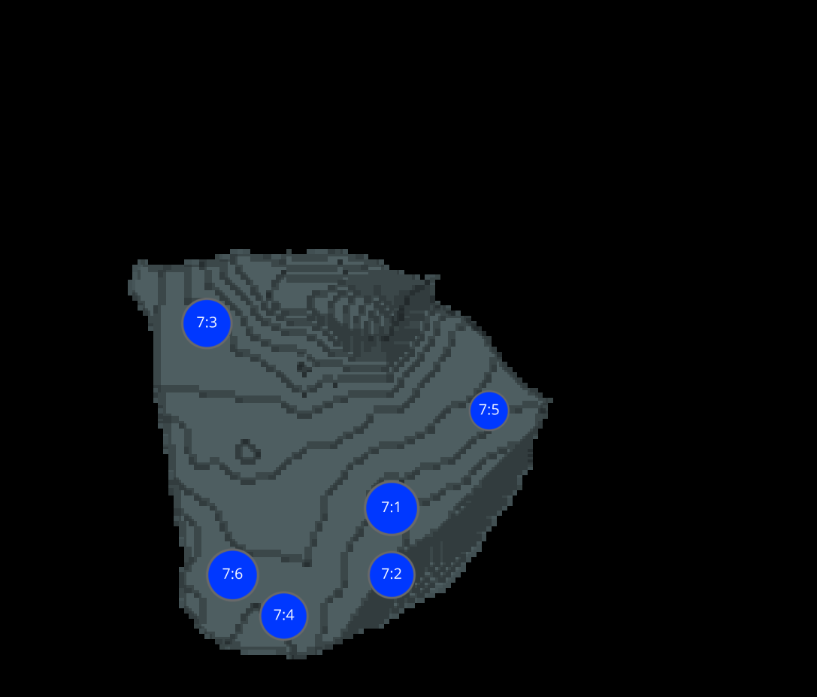
L3 1 CELLS

Slide 23
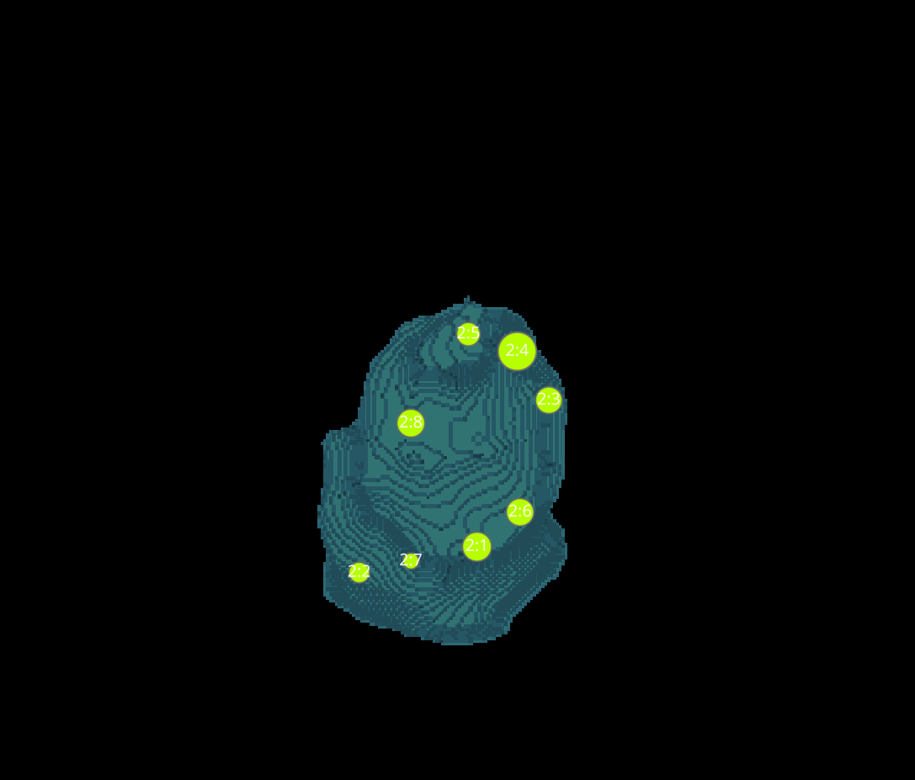
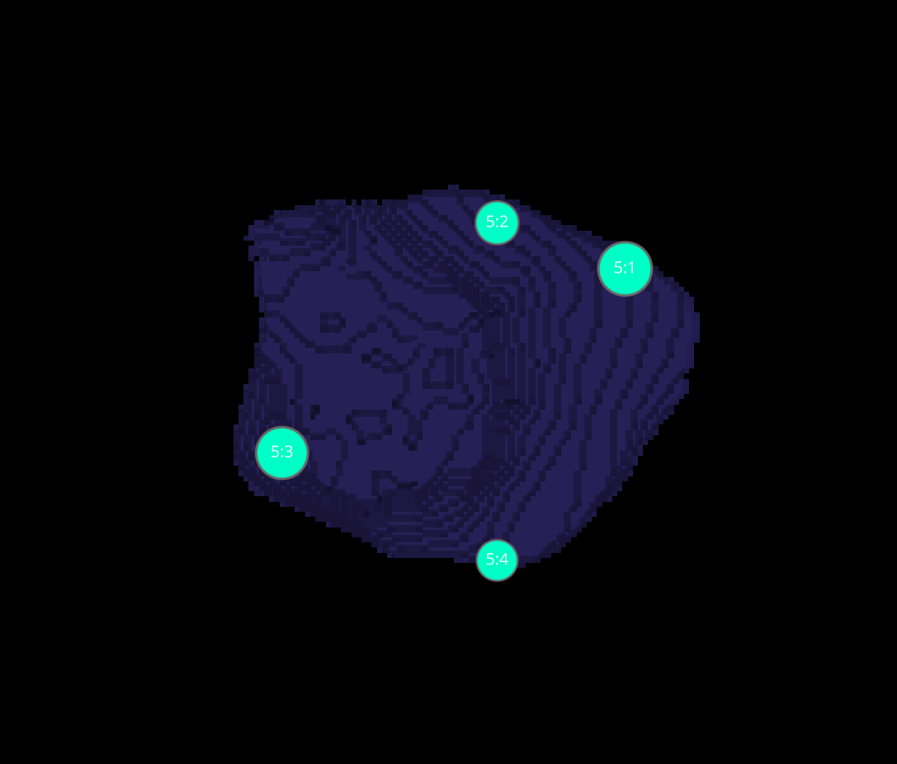
L3 1 CELLS

Slide 24
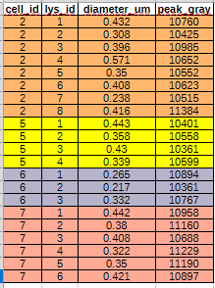
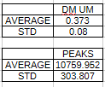
DATASETS L3-1

Slide 25
L3 1(CELL IMAGES, SAME PARAMETERS GUI)
WITH SPOTIFLOW
WITHOUT SPOTIFLOW

